Slide 1
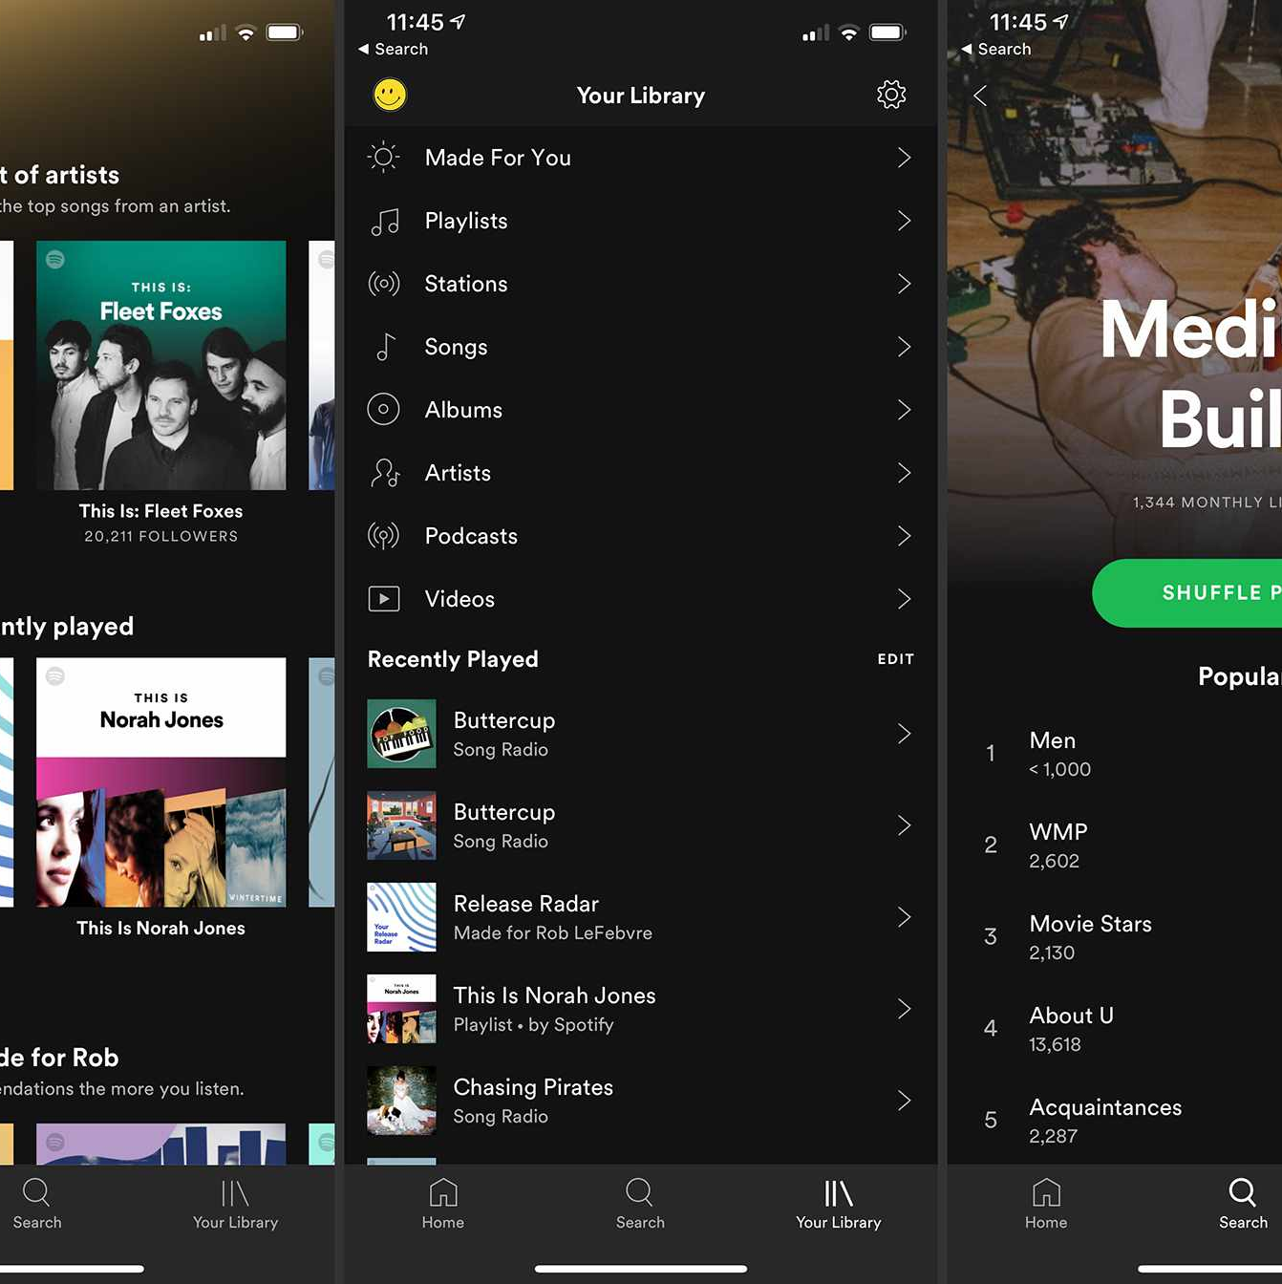
Music Recommender System
Batch 16

Slide 2
What is a Recommender System ?
A Recommender System refers to a system that Predicts the future preference of a set of items for a user, and recommend the top items.

Slide 3
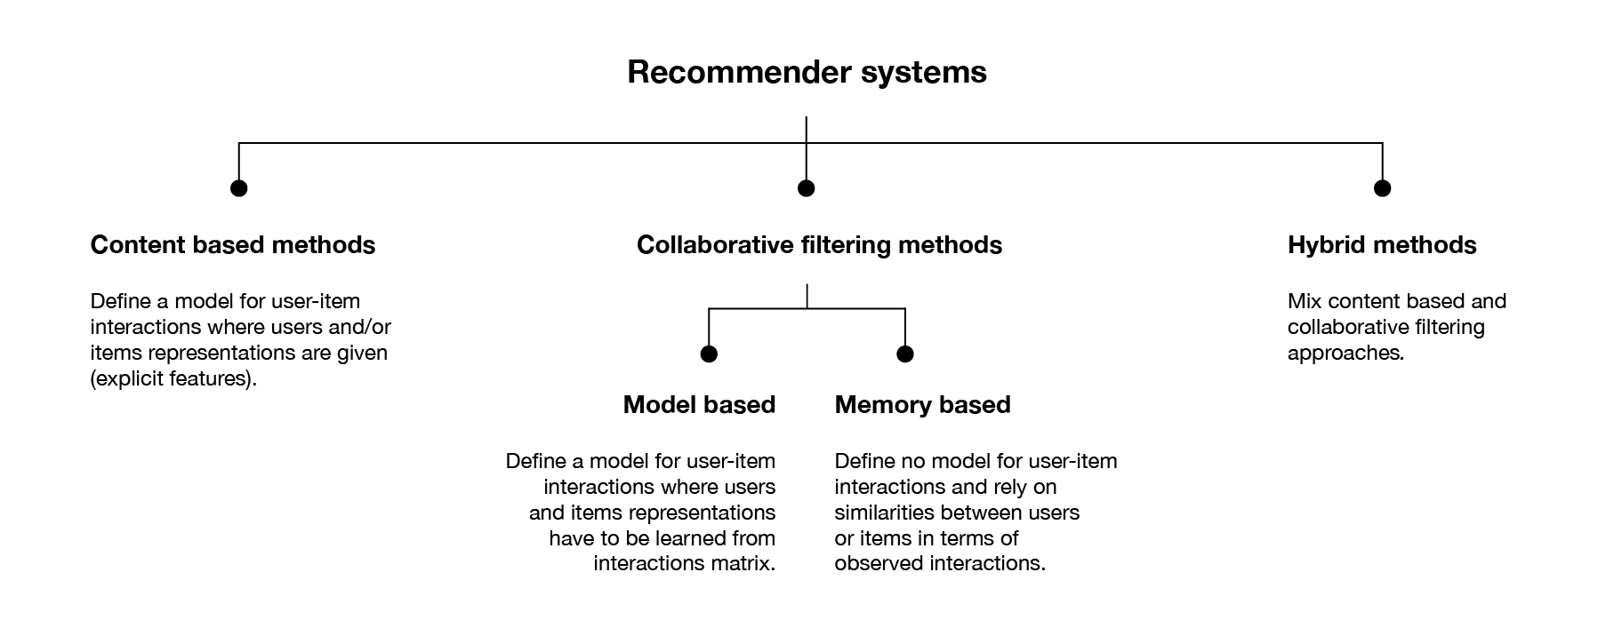

Slide 4
Collaborative Filtering
Collaborative filtering is a method of making automatic predictions about the interests of a subscriber which uses similarities between subscribers and items simultaneously to provide recommendations.The standard method of collaborative Filtering is known as Nearest Neighborhood algorithm.

Slide 5
Classification of Collaborative Filtering
Memory based classification can be divided into two types.
User Based Collaborative Filtering
Item Based Collaborative Filtering

Slide 6
User Based Collaborative / Explicit Filtering
If the subscriber specifies his interest towards a particular item by providing a numerical rating and peer users with similar taste will be recommended with those items.
It is also called as Explicit Filtering

Slide 7
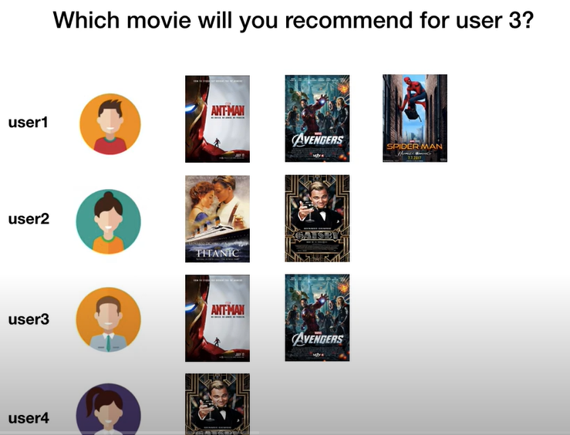
Use Case -1

Slide 8
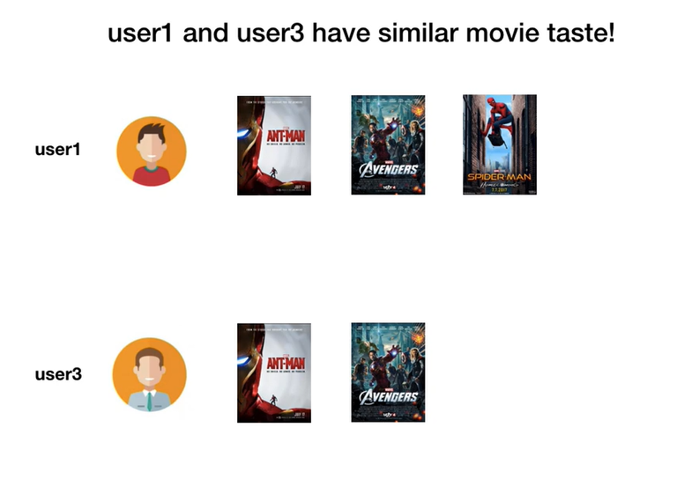

Slide 9
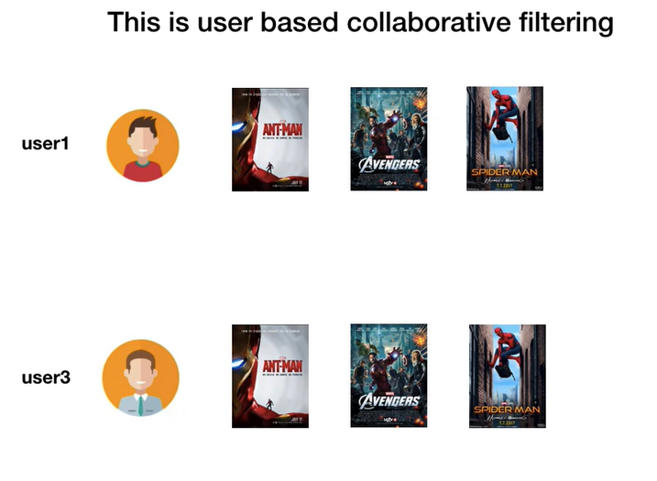

Slide 10
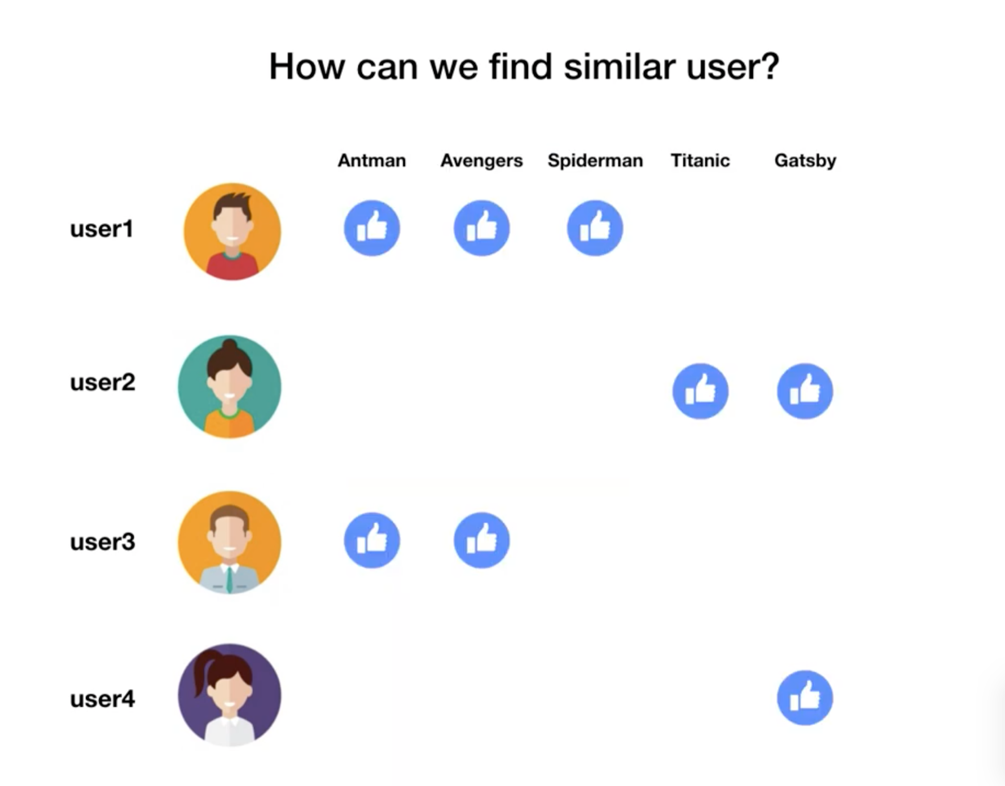
Story Behind

Slide 11
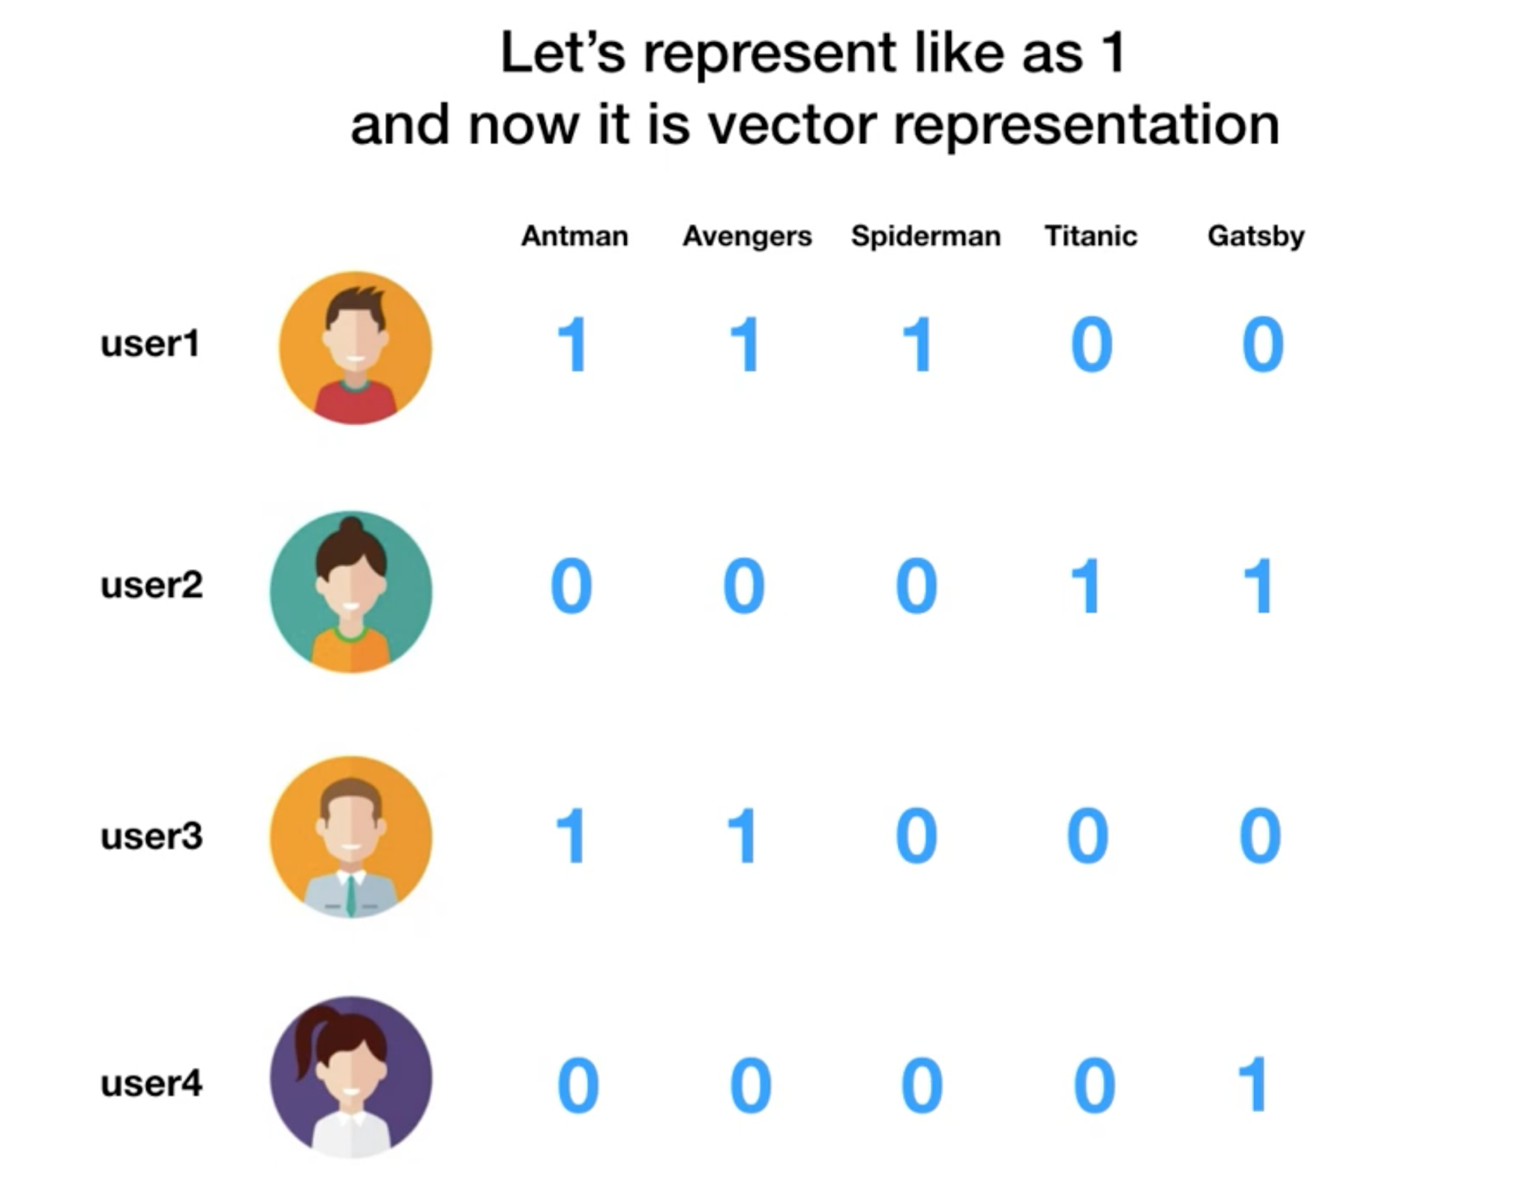

Slide 12
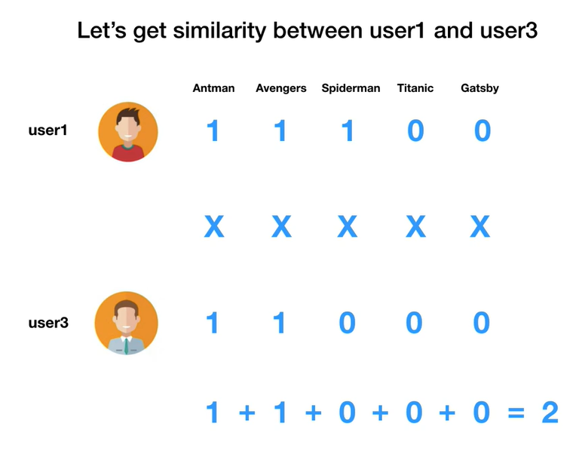

Slide 13
Cosine Similarity
The Cosine similarity is a measure of similarity between two non-zero vectors of an inner product space, which is a measurement of how similar are the preferences between these two people.

Slide 14
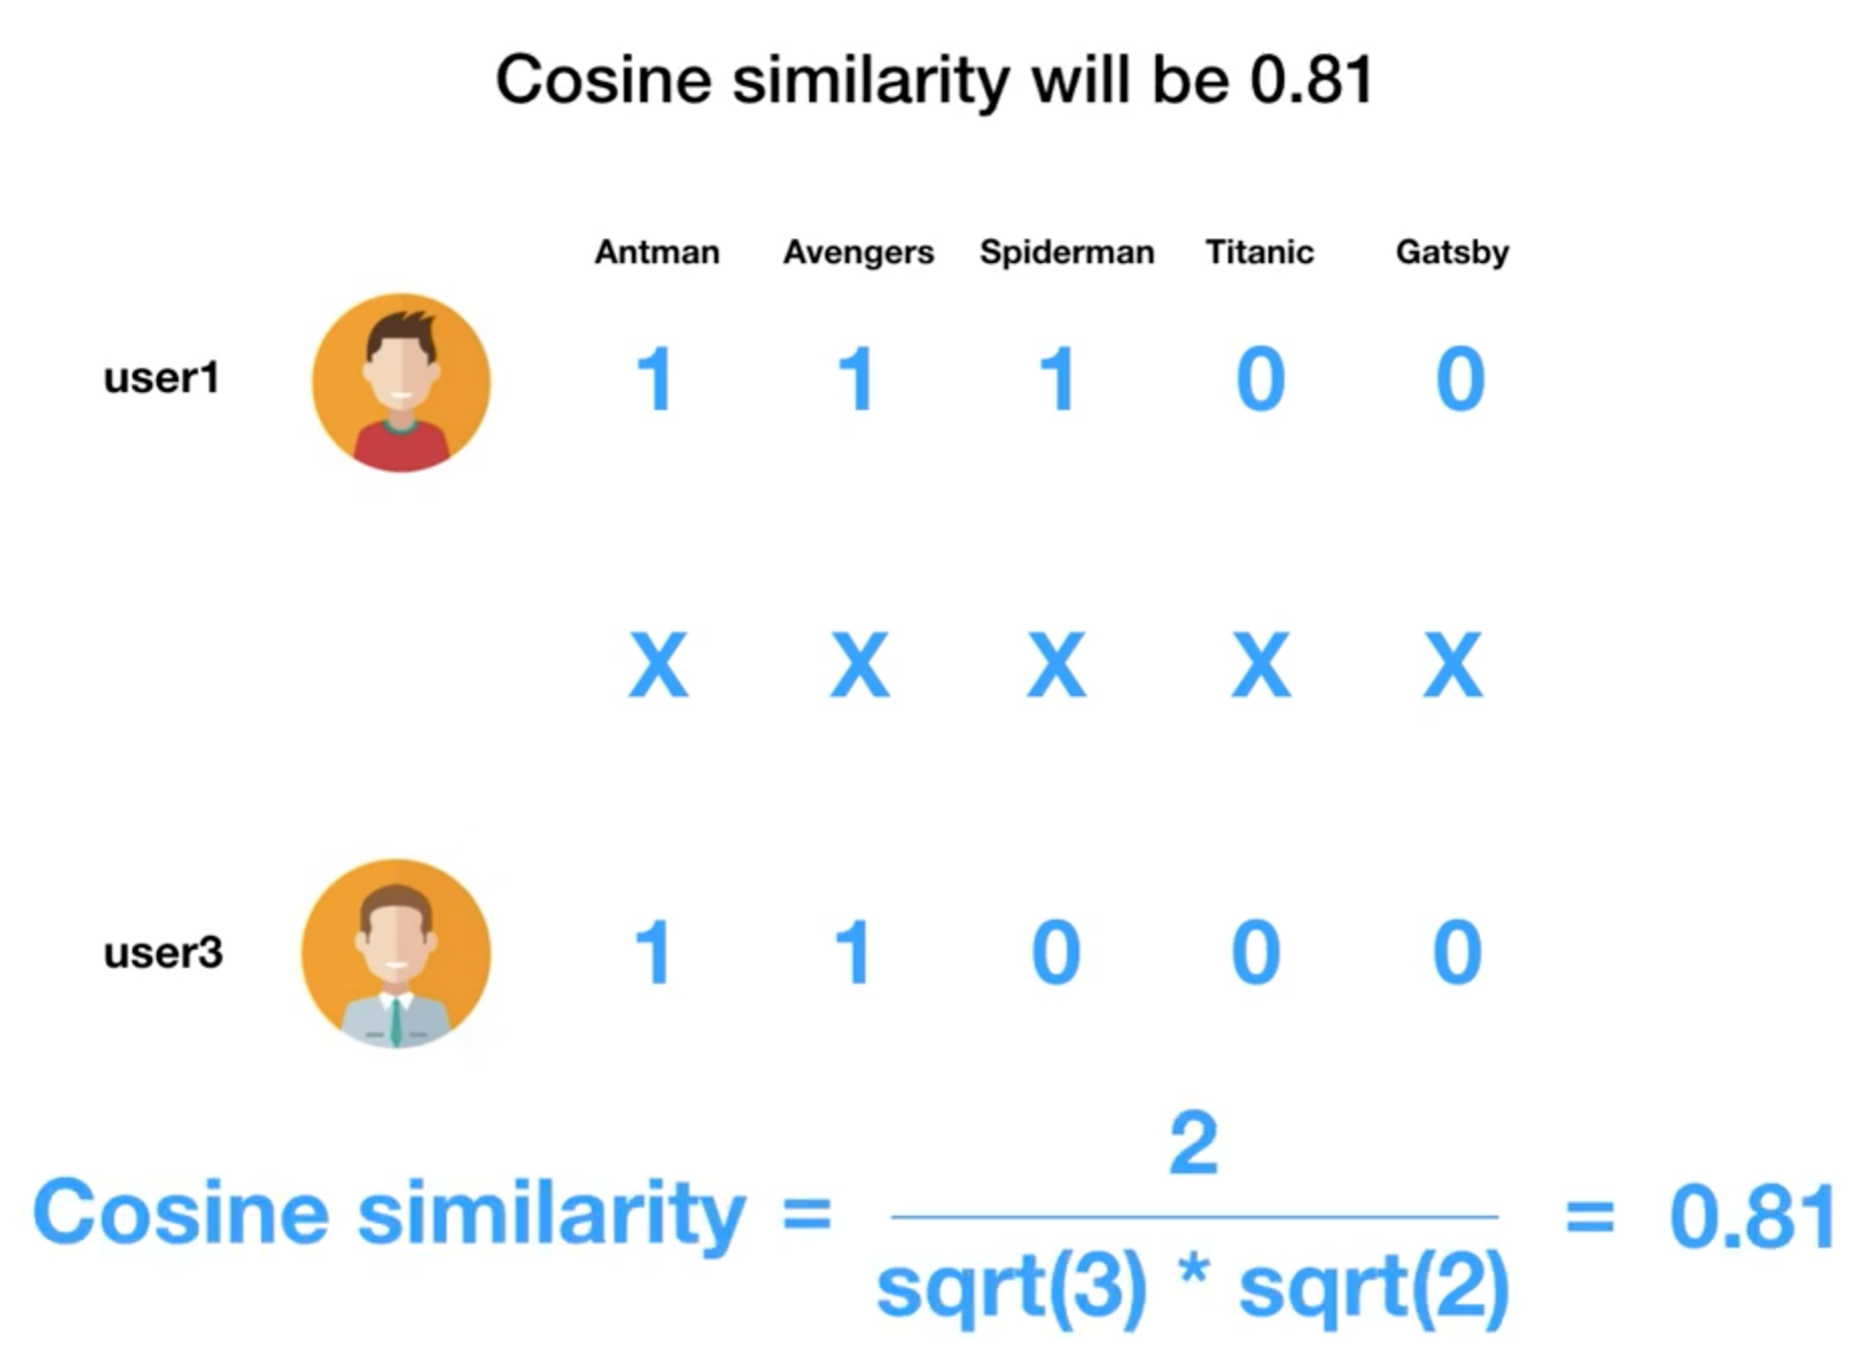

Slide 15
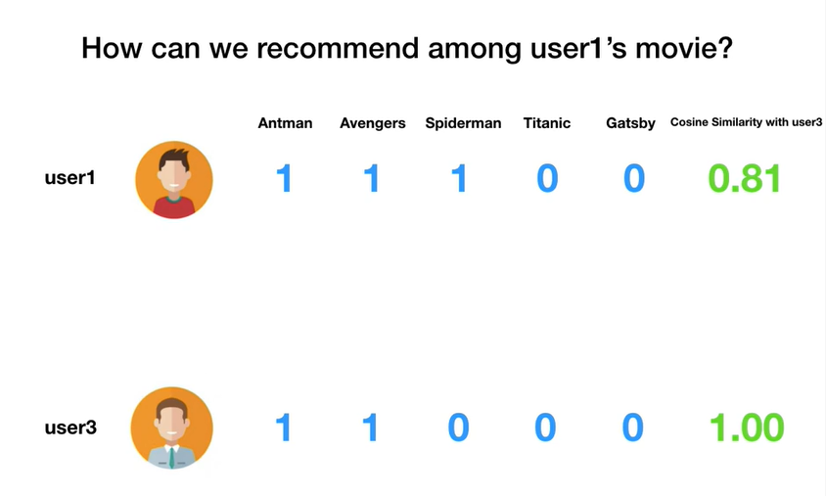

Slide 16
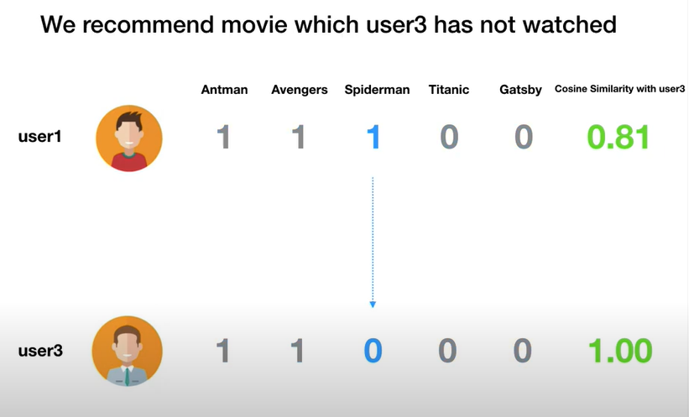

Slide 17
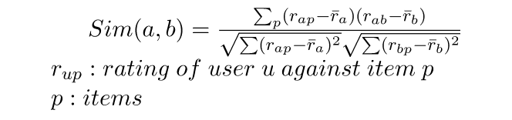
Use case -2 ( Some Math behind)
Lets Understand this use case in simple steps:
Step 1: Finding the similarity of users to the target user U.
Similarity for any two users ‘a’ and ‘b’ can be calculated from the given formula,

Slide 18
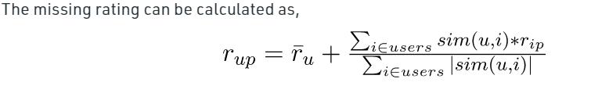
Step 2: Prediction of missing rating of an item

Slide 19
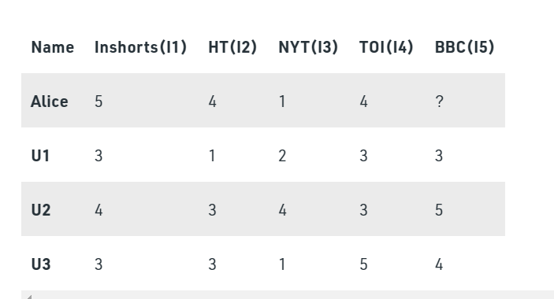
Consider a matrix which shows four users Alice, U1, U2 and U3 rating on different news apps. The rating range is from 1 to 5 on the basis of users likability of the news app. The ‘?’ indicates that the app has not been rated by the user.

Slide 20
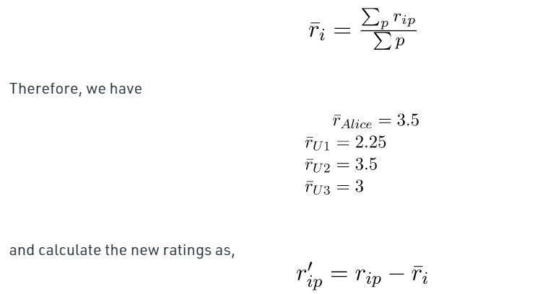
Step 1: Calculating the similarity between Alice and all the other users
At first we calculate the averages of the ratings of all the user excluding I5 as it is not rated by Alice. Therefore, we calculate the average as

Slide 21
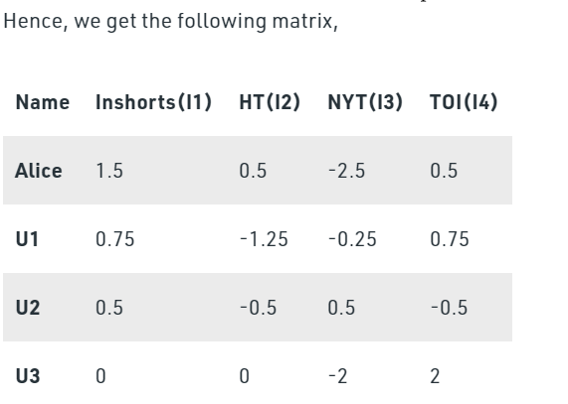

Slide 22
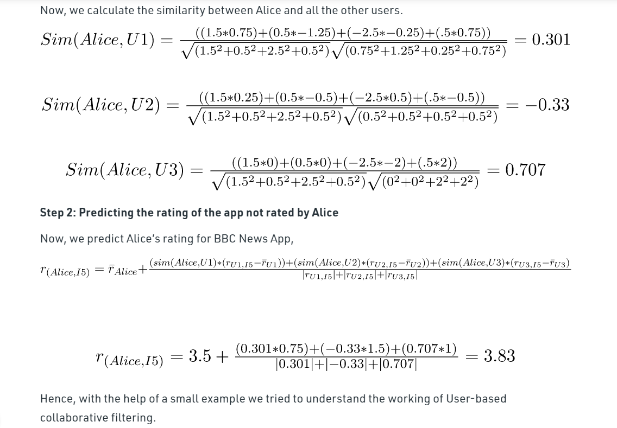

Slide 23
Item Based Collaborative/ Implicit Filtering
Item based Collaborative filtering is based on the similarity between items calculated using people's ratings of those items.
It is also called as Implicit Filtering.

Slide 24
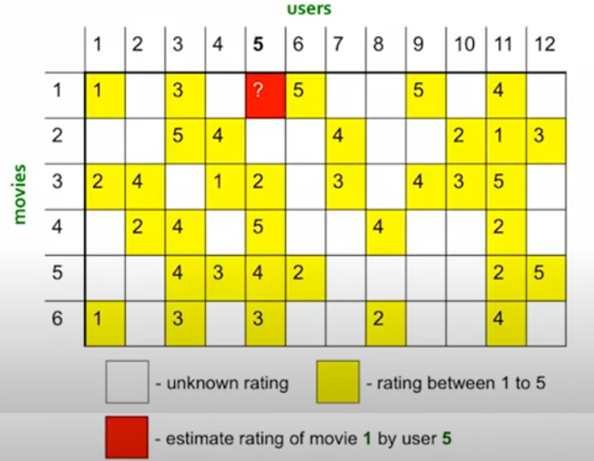
Use Case & story behind
Problem Statement:
Estimate rating of Movie 1 by User 5?
Create a Sparse Matrix
Note:
1. All ratings are between 1 & 5 (1 being lower and 5 being higher)
2. Blank blocks are unknown ratings / user hav’nt provided the ratings.

Slide 25
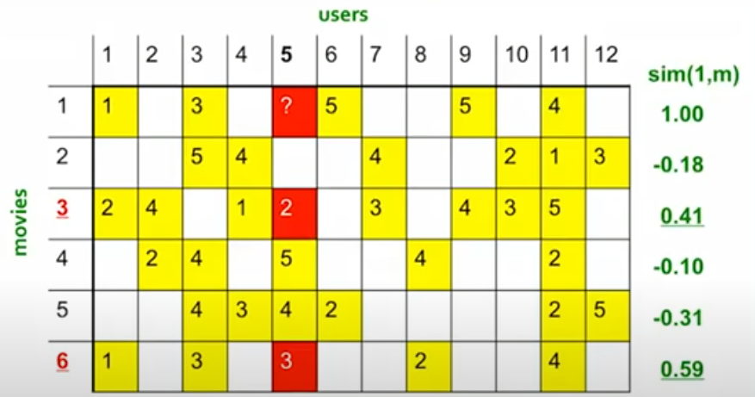
Problem Statement:
Estimate rating of Movie 1 by User 5?
a. Calculate similarity of Movie 1 rest of the movies (m)
Note:
Here we are using Cosine similarity
1. Subtract mean rating (M1) from each Movie (i)
M1 = (1+3+5+5+4)/5 = 3.6
Row1 = [-2.6,0,-0.6,0,0,1.4,0,0,1.4,0,0.4,0]
2. Compute Cosine similarities between Rows. Cosine similarity hsa been explained in detail in User-User section

Slide 26
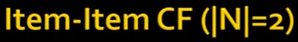
Problem Statement:
Estimate rating of Movie 1 by User 5?
Identify movies similar to Movie1 - these set of movies are called Neighbours
In our case we have limited the neighbours N to 2.
Based on which our selected Neighbours movies are Movie3 & Movie6
Note:
1. Ensure selected neighbours include rating by User 5
2. Select movies with highest values of sim(1,m)

Slide 27
Problem Statement:
Estimate rating of Movie 1 by User 5?
Estimate the Movie rating by using simple weighted Avg.
In our case R15 = 2.6
Using similar approach find ratings of all blanks (Rrc)
Note:
R15 = (0.41*2 + 0.59*3)/(0.41+0.59)

Slide 28
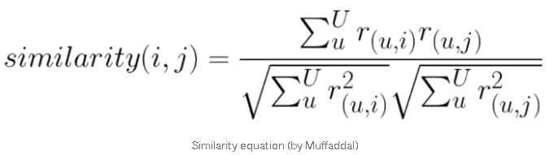
Some Math behind
Lets Understand the use case in simple steps:
Step 1: Finding the similarity of Movie1 to other Movies.
Similarity for any two movies ‘i’’ and ‘j’ can be calculated from the given formula,

Slide 29
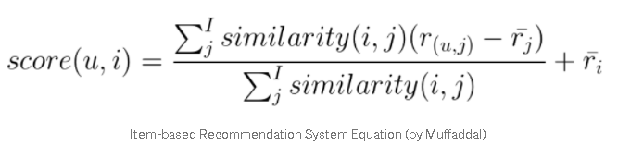
Step 2: Prediction of missing rating of an item

Slide 30
Item Based Collaborative filtering
In practice, Item-Item recommenders outperforms User-User recommenders in most use cases
The reasons being:
Items are simpler than Users.
Items belong to small set of ‘genre’, while users have complex tastes.
Item similarity is more meaningful than User similarities.
Item to Item collaborative filtering works better than User to User collaborative filtering

Slide 31
Cold Start Problem
The Cold Start Problem refers to when items added to the catalogue have either none or very little interactions. This constitutes a problem mainly for collaborative filtering algorithms since they rely on the item's interactions to make recommendations.
The Cold start problem can be classified into
New System
New User
New Model

Slide 32
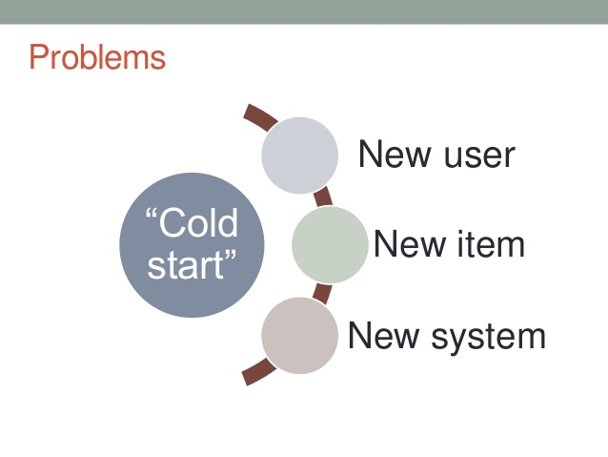

Slide 33
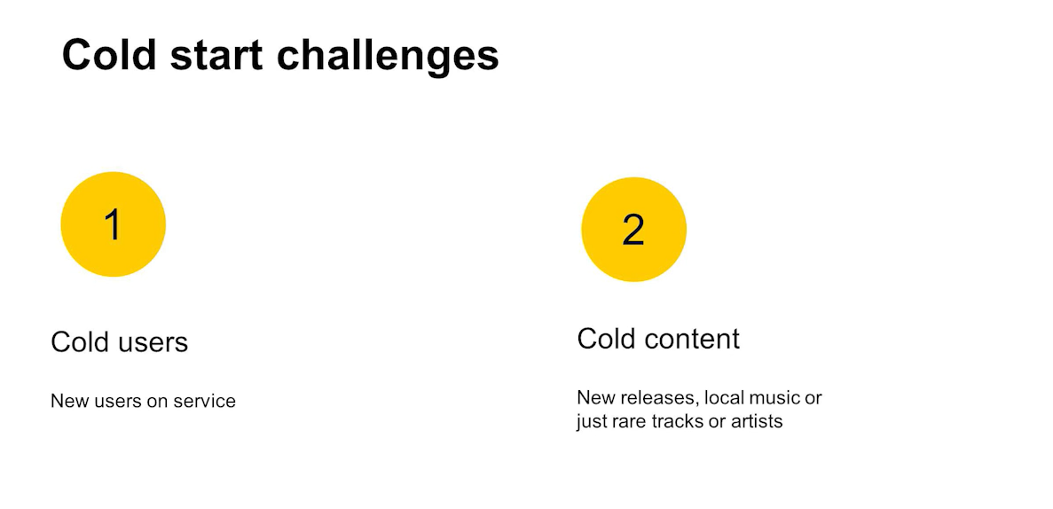

Slide 34
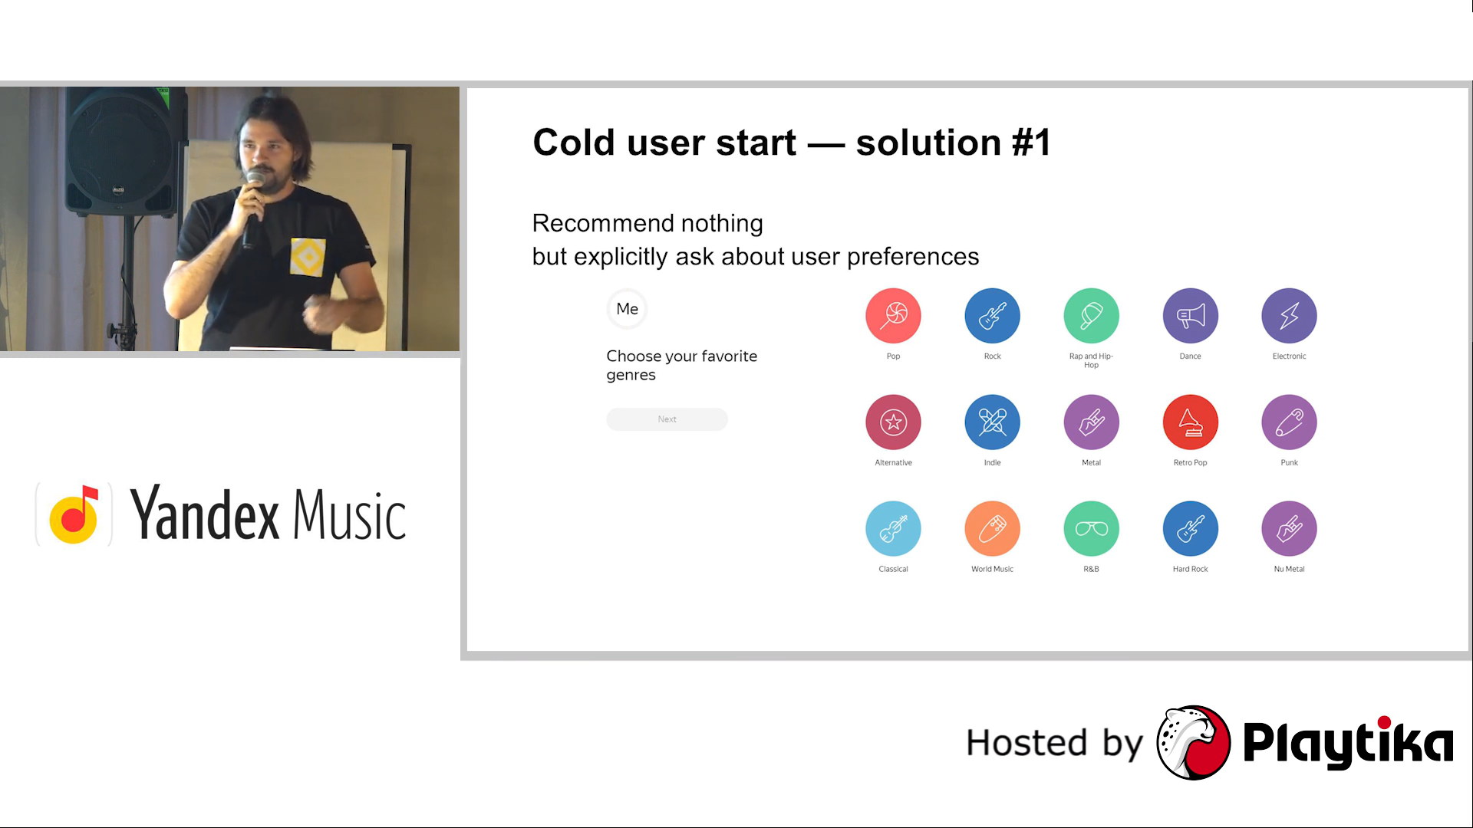

Slide 35
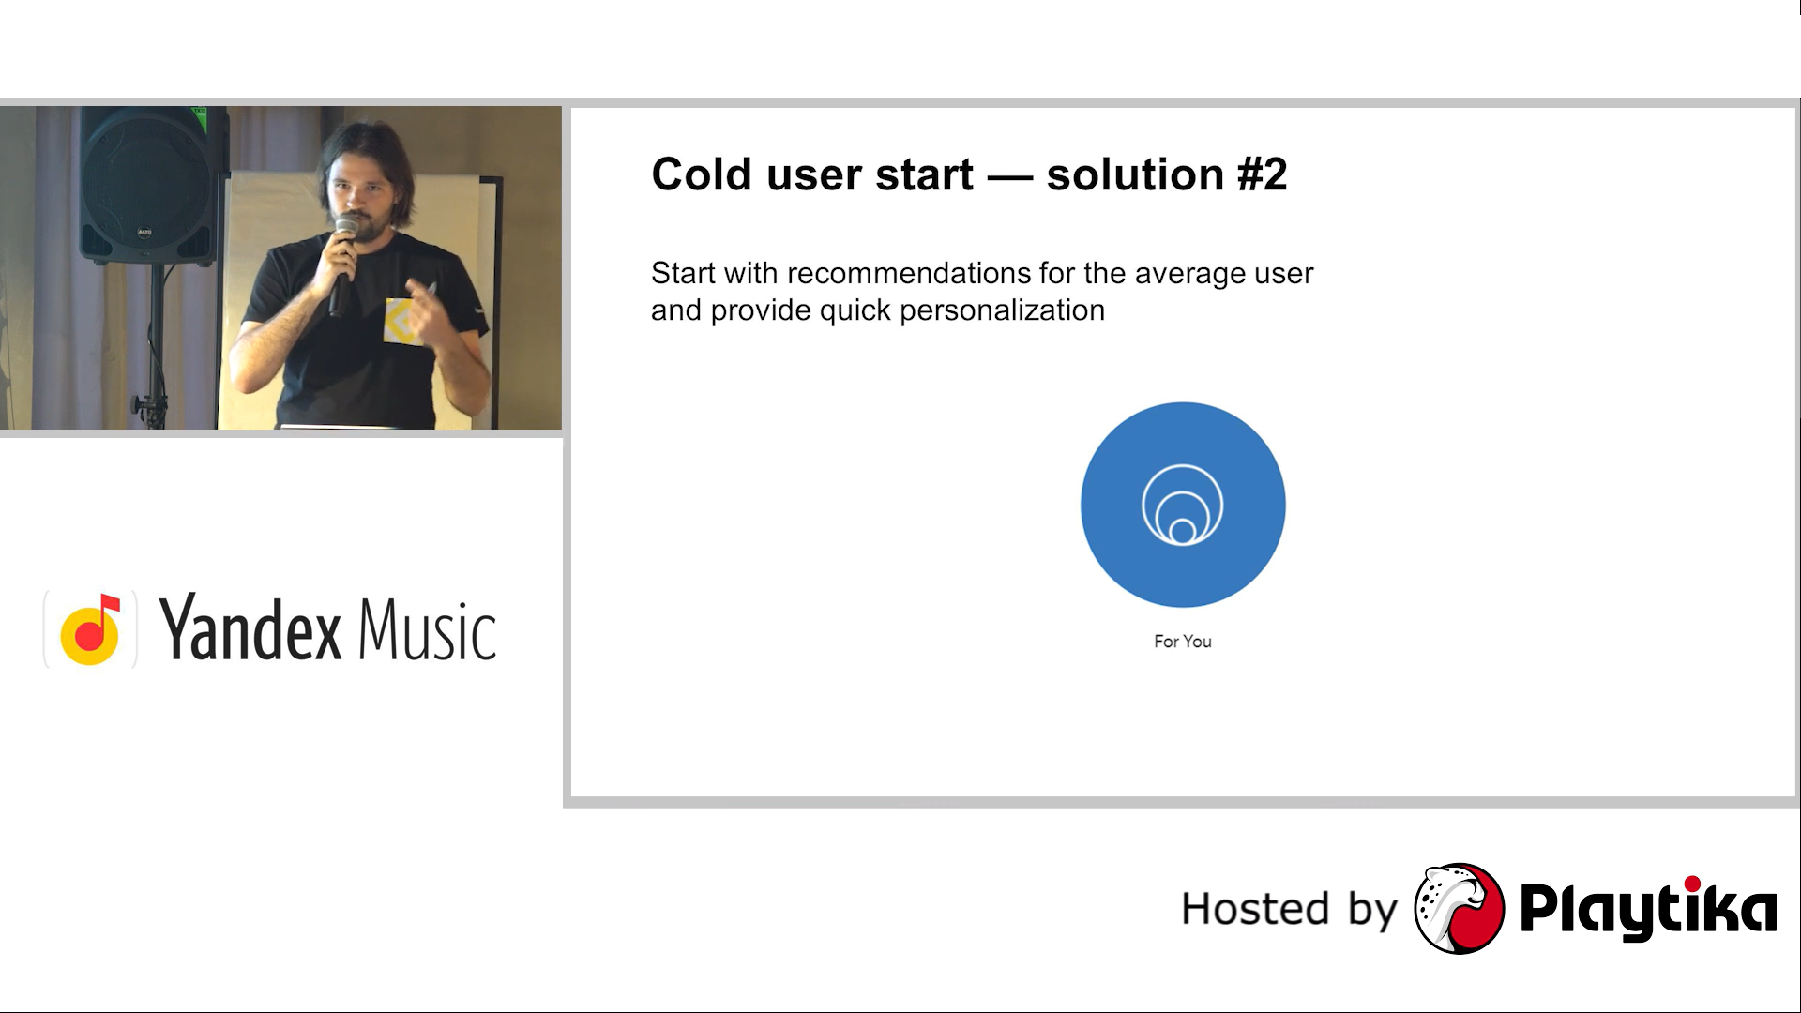

Slide 36
Understanding​ Implicit Feedback
Recommender systems rely on two different types of feedback (input). The most convenient is the high quality explicit feedback, that consists of an explicit preference given by a user for a given item. Often explicit feedback is collected via a star rating system. However, this kind of (precious) feedback is not always available (only few user give explicit feedback for items they have purchased) so recommender systems have to infer user preferences from the far more abundant implicit feedback. In an implicit model, once the user has given consent to collecting usage data, no additional explicit feedback action (e.g. ratings) is required on the user's side.
Implicit feedback includes purchase history, browsing history, search patterns, etc. For example, a user that purchased many books by the same author probably likes that author.

Slide 37
Implicit feedback is noisy
When tracking users behaviour we can only guess their preference and true motives. For example we may collect a purchase action for a user, but this does not necessary imply a positive feedback. The item could have been purchased as a gift, or it could also be that the user was disappointed with the item.
So, to recap. Implicit feedback is data we gather from the users behaviour, with no ratings or specific actions is
needed. It could be what items a user purchased, browsing history, search patterns, how many times they played a song or watched a movie, how long they’ve spent reading a specific article etc. The upside is that we have a lot more of this data, the downside is that it’s more noisy and not always apparent what it means. Working with implicit feedback is harder than working with explicit feedback, but it's something a recommender system cannot (should not) avoid.

Slide 38
New User
The new user case refers to when a new user registers into the platform and has not provided any interaction yet, therefore it is not possible to provide personalized recommendations.
In such case for a certain period of time the recommender has to provide recommendations without relying on the user's past feedbacks, since none has occurred yet.
The main strategy in dealing with new users is to ask them to provide some preferences to build an initial user profile. A threshold has to be found between the length of the user registration process, which if too long might indice too many users to abandon it, and the amount of initial data required for the recommender to work properly.

Slide 39
Continuation
New Item - A new item is added to the platform, it might have some content information but no interactions/ feedbacks are present. In such case collaborative filtering will not work.
In Such case we will use content based filtering Technique.
New System -The new platform refers to the beginning of the system, when virtually there is no feedback is present in the recommender. This case presents the disadvantages of both the New user and the New item case, as all items and users are new.

Slide 40
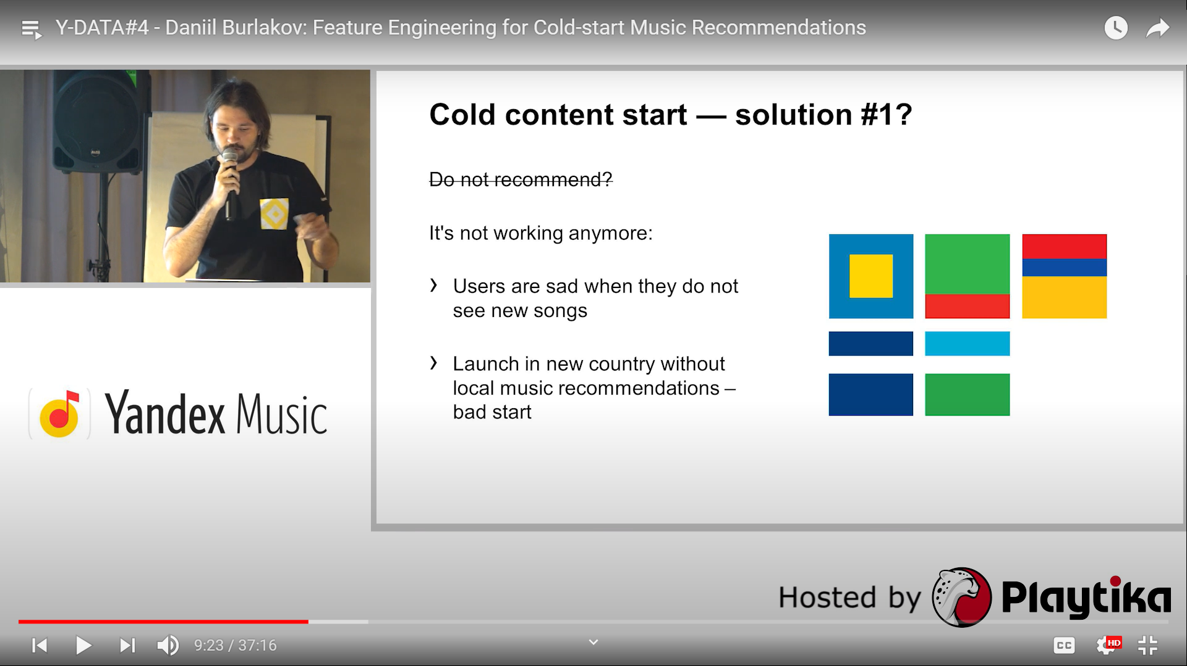

Slide 41
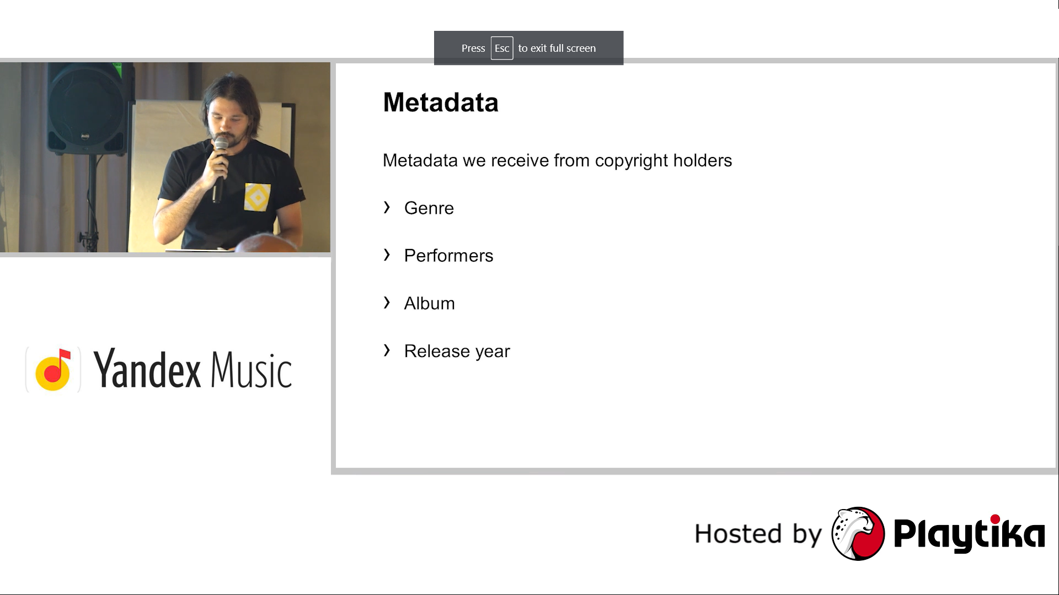

Slide 42
Content Based Filtering Technique
Content-based filtering is a technique used to recommend items based on the comparison between the content / genre of the items and the user profile. The content of each item is represented as a set of descriptors or terms, The user profile is represented with the same terms and built up by analysing the content of items which have been seen by the user.
The Recommendations are User Specific. And solves the New Item Cold Start Problem.

Slide 43
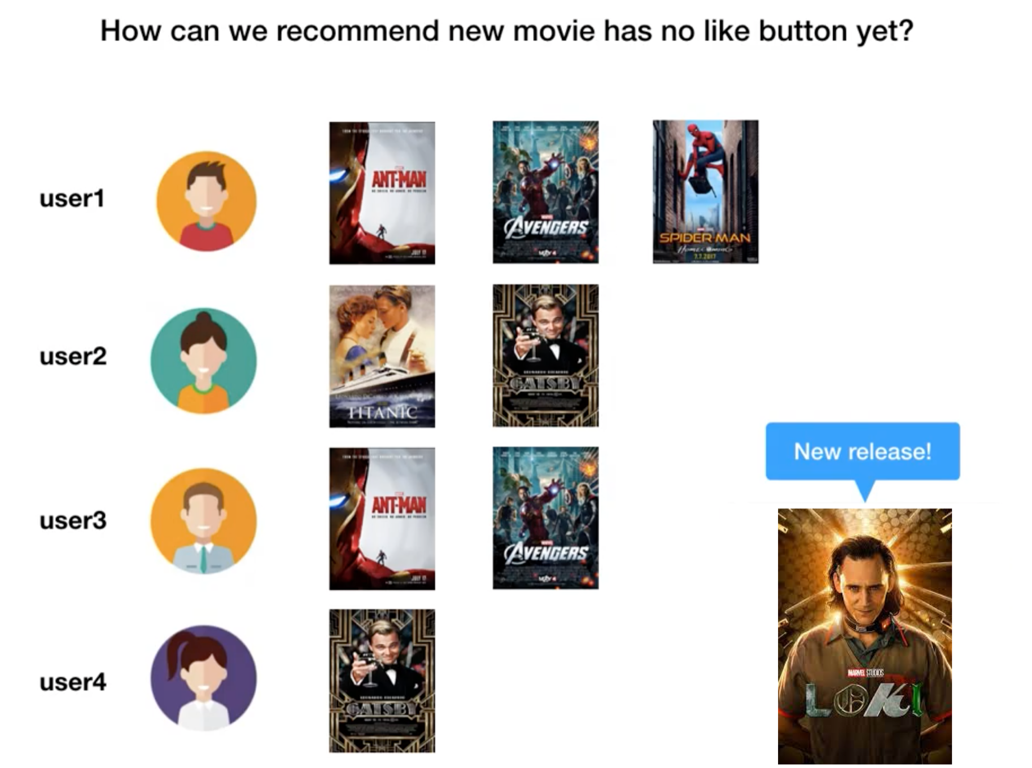

Slide 44
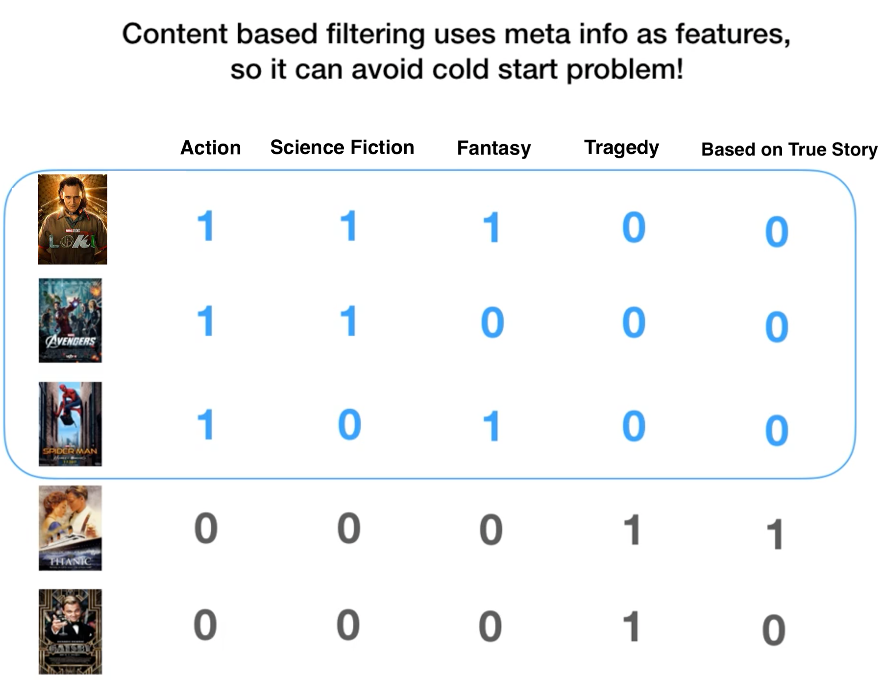

Slide 45
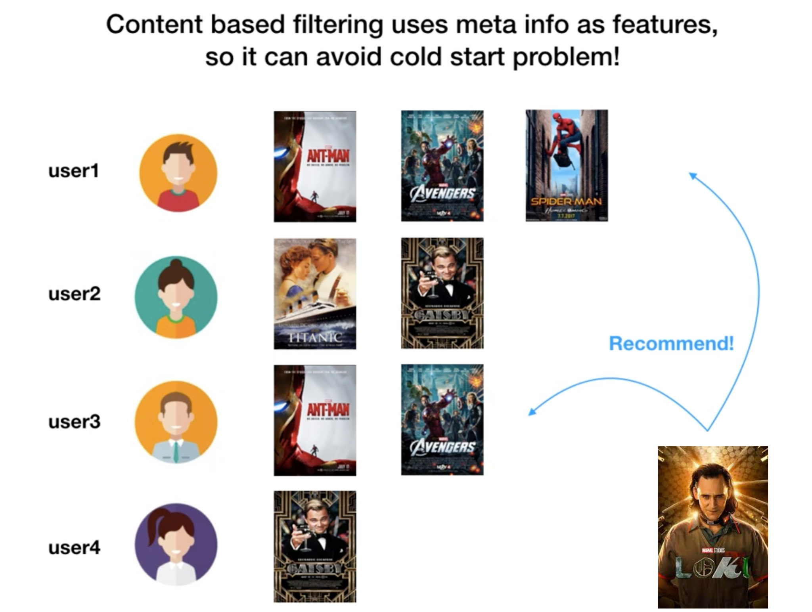

Slide 46
Advantages
The model doesn't need any data about other users, since the recommendations are specific to this user. This makes it easier to scale to a large number of users.
The model can capture the specific interests of a user, and can recommend relatively new items that very few other users are interested in.

Slide 47
Disadvantages
Since the feature representation of the items are hand-engineered to some extent, this technique requires a lot of domain knowledge. Therefore, the model can only be as good as the hand-engineered features.
The model can only make recommendations based on existing interests of the user. In other words, the model has limited ability to expand on the users' existing interests.

Slide 48
Explanation
Data Preprocessing
Feature Engineering
Built Naive Bayes , Logistic Regression, Random Forest and Length GBM
Prepare Data
Model Data
Evaluate
Model Select & Optimize
Operationalize

Slide 49
Expected Project Timeline
Start Date | End Date | Topics
7 June 2021 | 10 June 21 | PowerPoint Presentation on Recommender System
11 June 2021 | 14 June 2021 | Exploratory Data Analysis PowerPoint Presentation and Execution
15 June 2021 | 21 June 2021 | Data Preparation , Content Based, Collaborative Based and Popularity Based Filtering
22 June 2021 | 26 June 2021 | Evaluation & final Improvements

